Slide 1
Malnutrition Free Villages through Health Kit

Slide 2
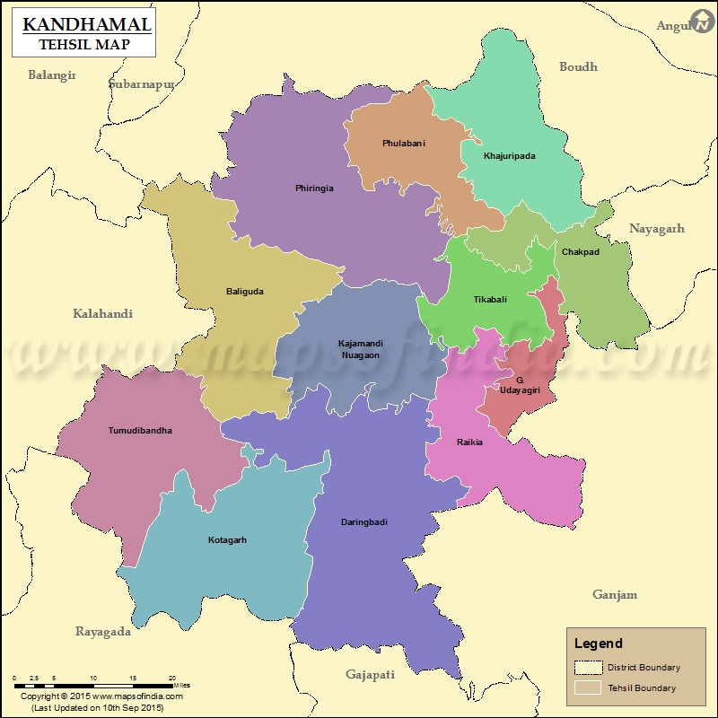
Inception of Health Intervention
Started in Daringbadi Block, Kandhamal District in 2014
After 2 years, it was extended to 3 Blocks;
Kotagarh
Baliguda
Tumudibandha

Slide 3
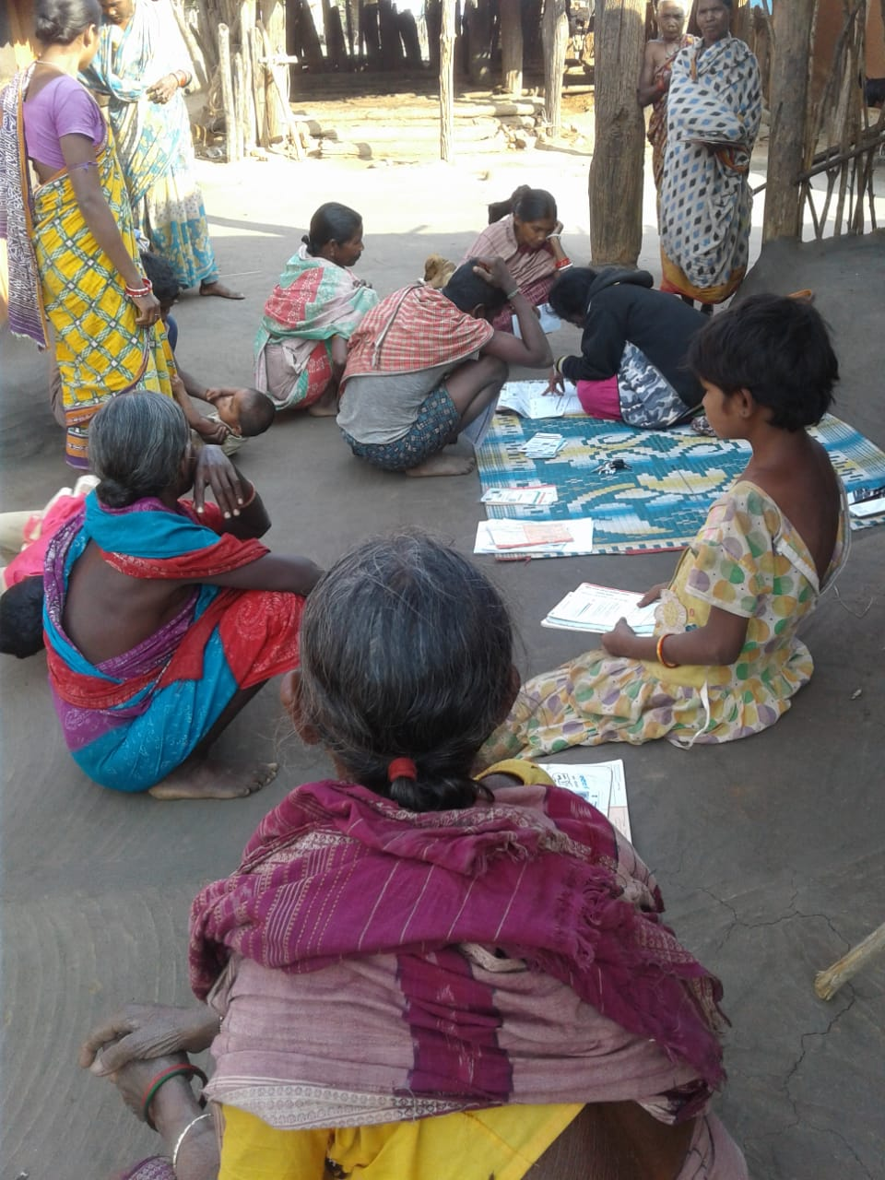
What is Health Kit?
It is a programme where basic preventive medicine is given to the community by trained village based Swasthaya Sathi (Health worker) with a formal consent by the villagers in the form of a signed resolution.
Why Health Kit?
In Kandhamal, approximately 71% of the land is covered by forest
Difficult for people from the hilly terrains to access medical facilities as Public Health Centers are far and few
Absence of private health system in the district and lack of knowledge of traditonal medicines

Slide 4
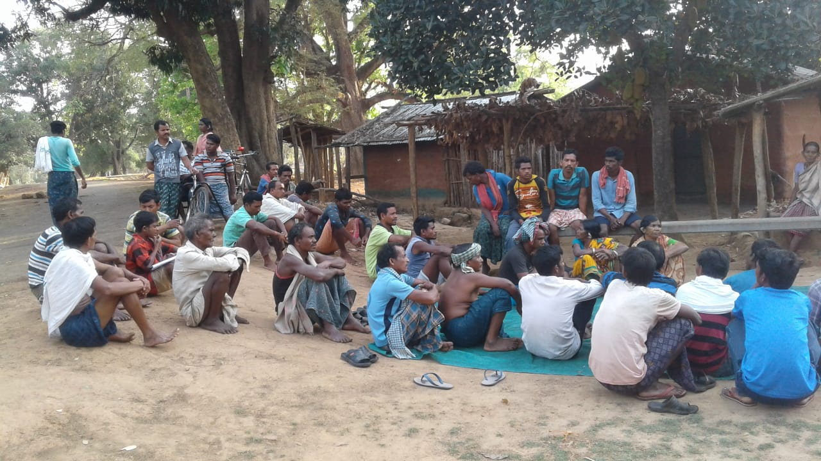
Objectives
Provide basic & immediate health services
Bring in behavioural change in terms of using toilets, hand washing, drinking boiled water, using mosquito net and eating habits
Promote kitchen & herbal garden to curb malnutrition
Make the Health Kit a locally sustainable model through community contribution, active participation and involvement of primary stakeholders
Empower women by building up strong women Sangathan to monitor food and nutrition issues
Government Stakeholders such as ASHA, ANM & ICDS workers and to regularize the public service delivery systems
Link the communities to the State and Central government health schemes and entitlements

Slide 5
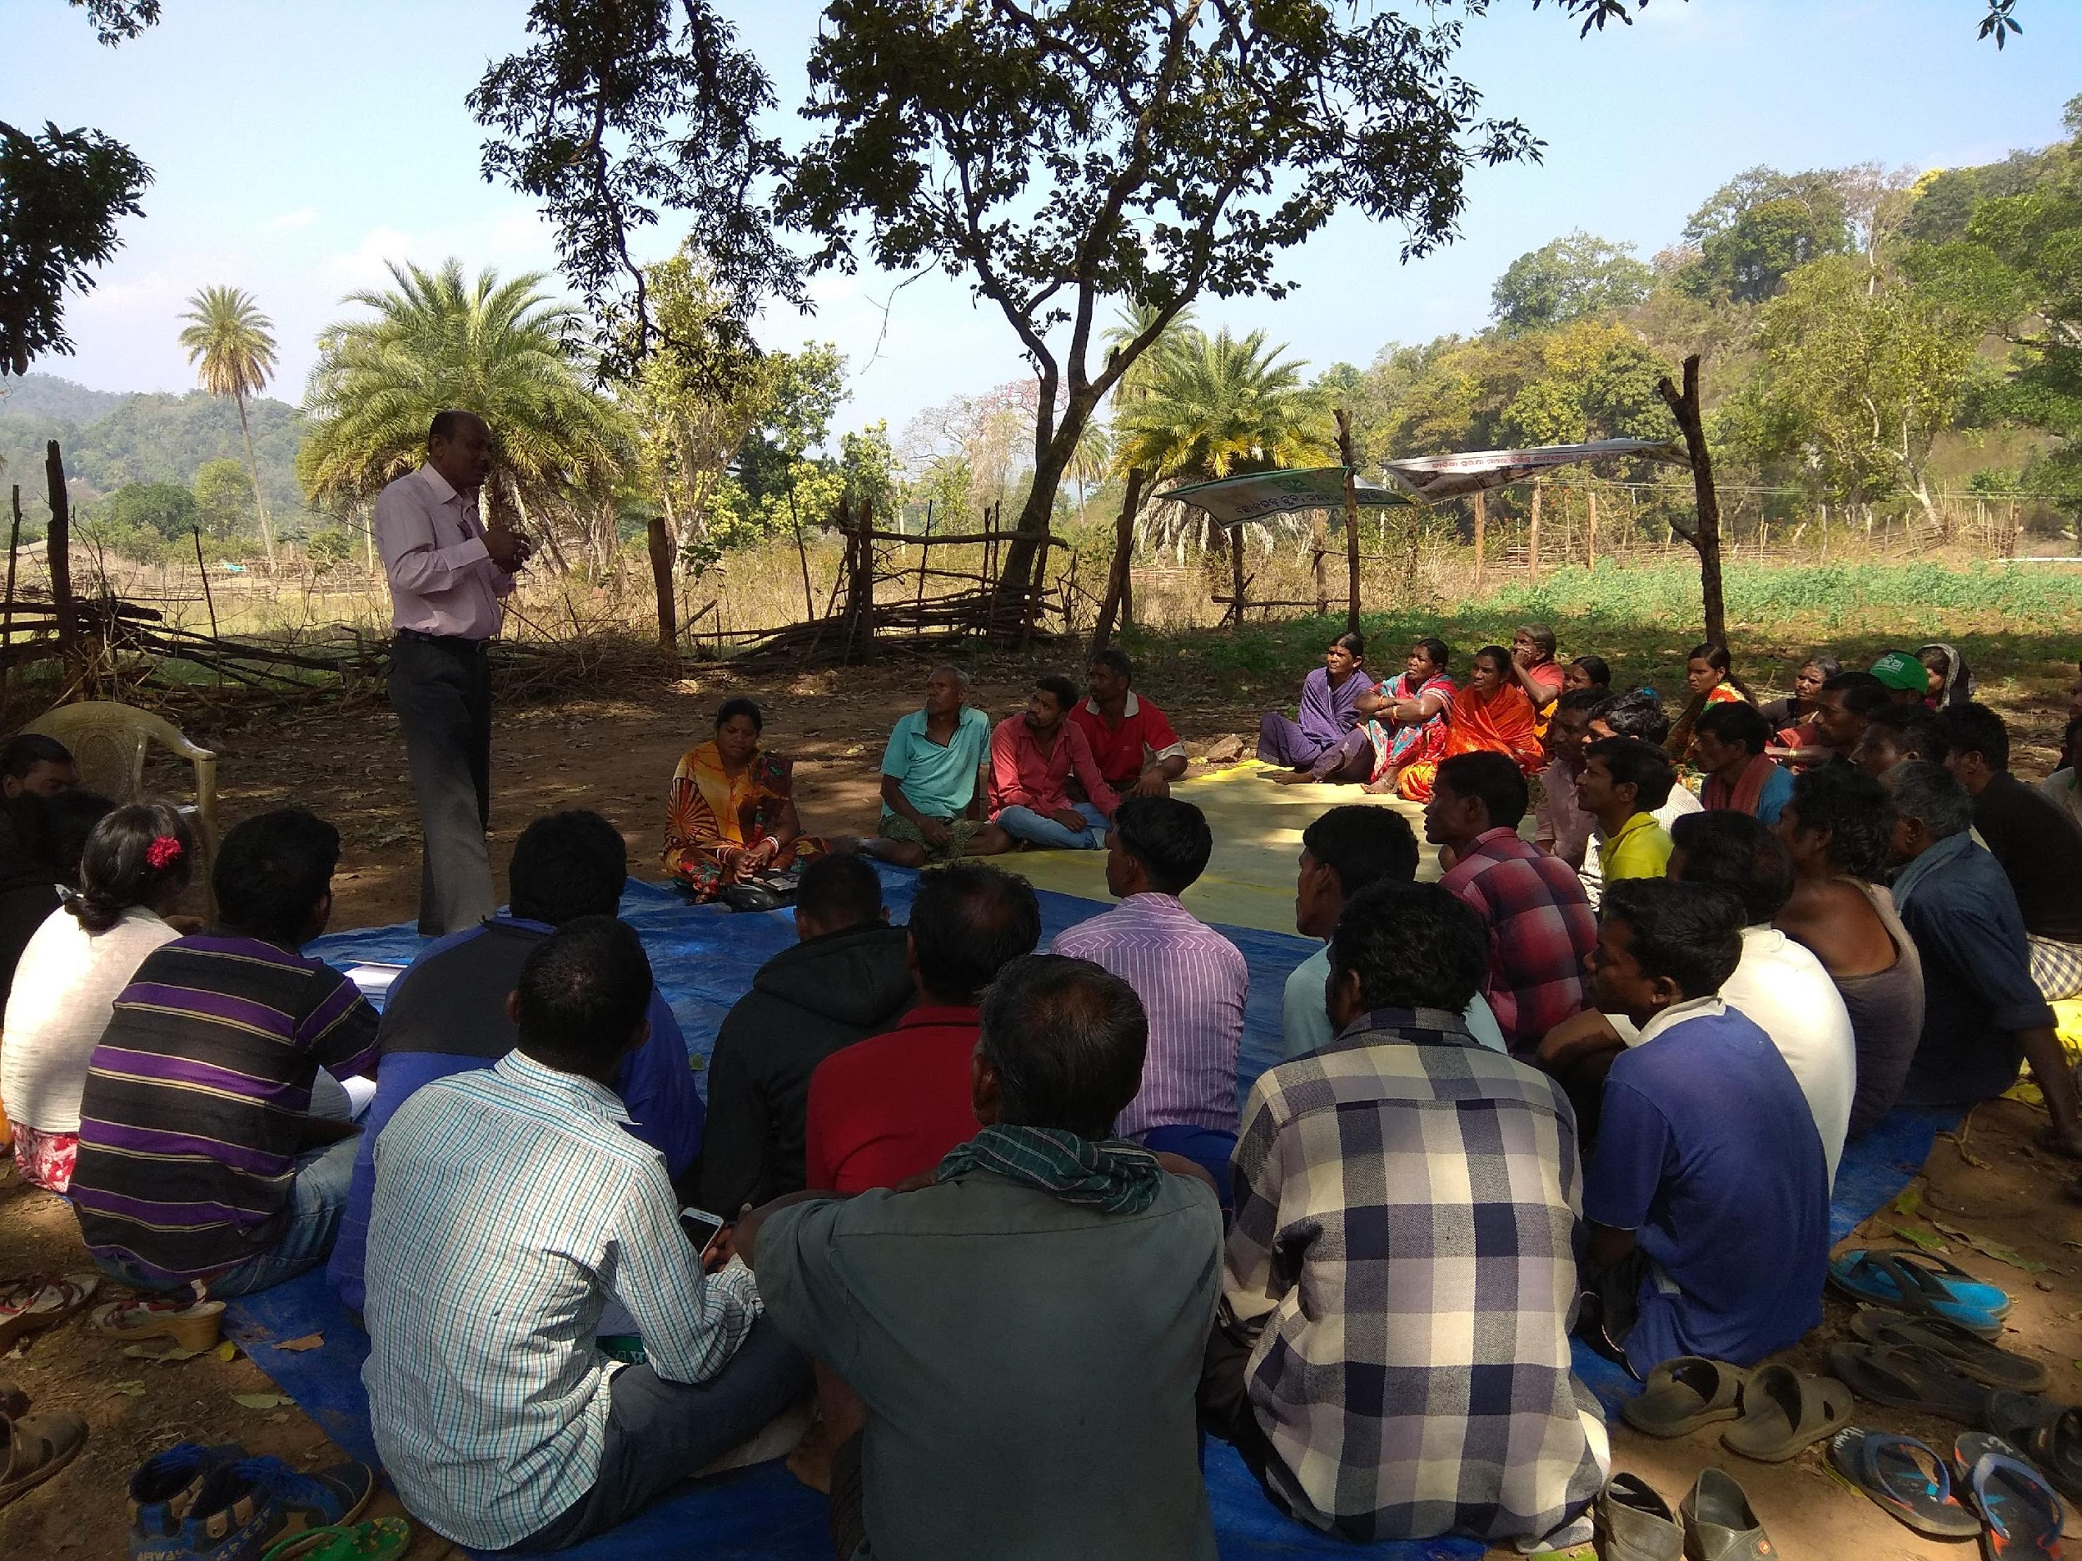
Awareness Meeting on health kit formation in the villages

Slide 6
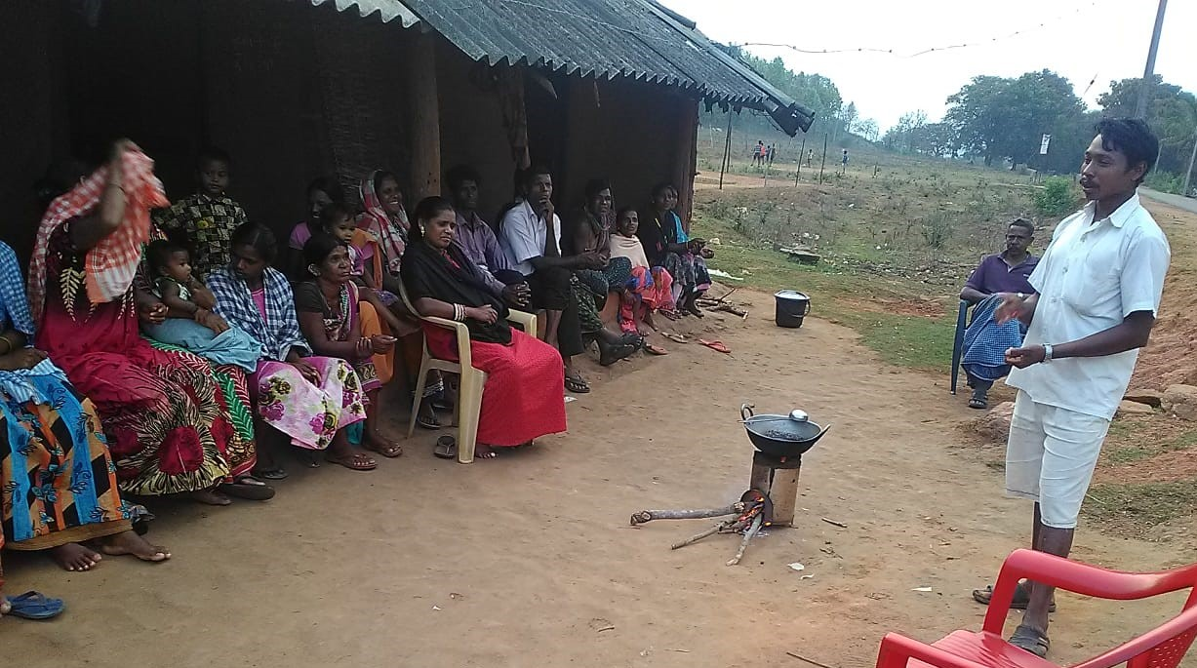
Creating Awareness on health kit-
Meeting with the community

Slide 7
Orientation to Swasthya Sathi

Slide 8
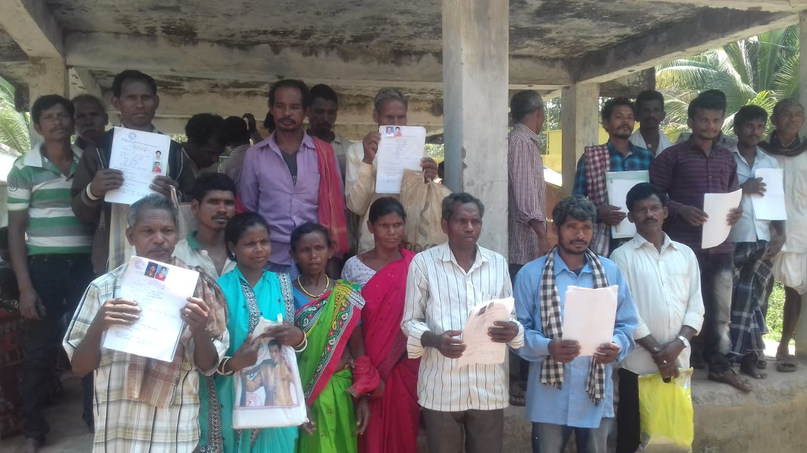
Data Collection from the Villagers

Slide 9
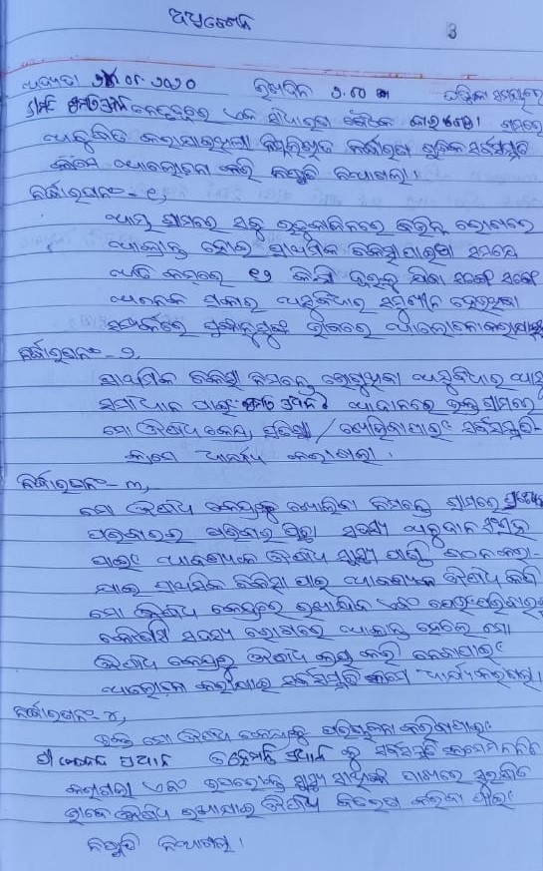
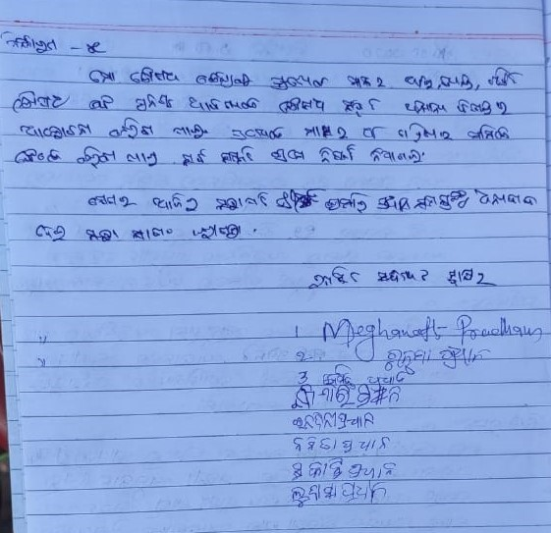
Village Resolution for Health it initiation

Slide 10
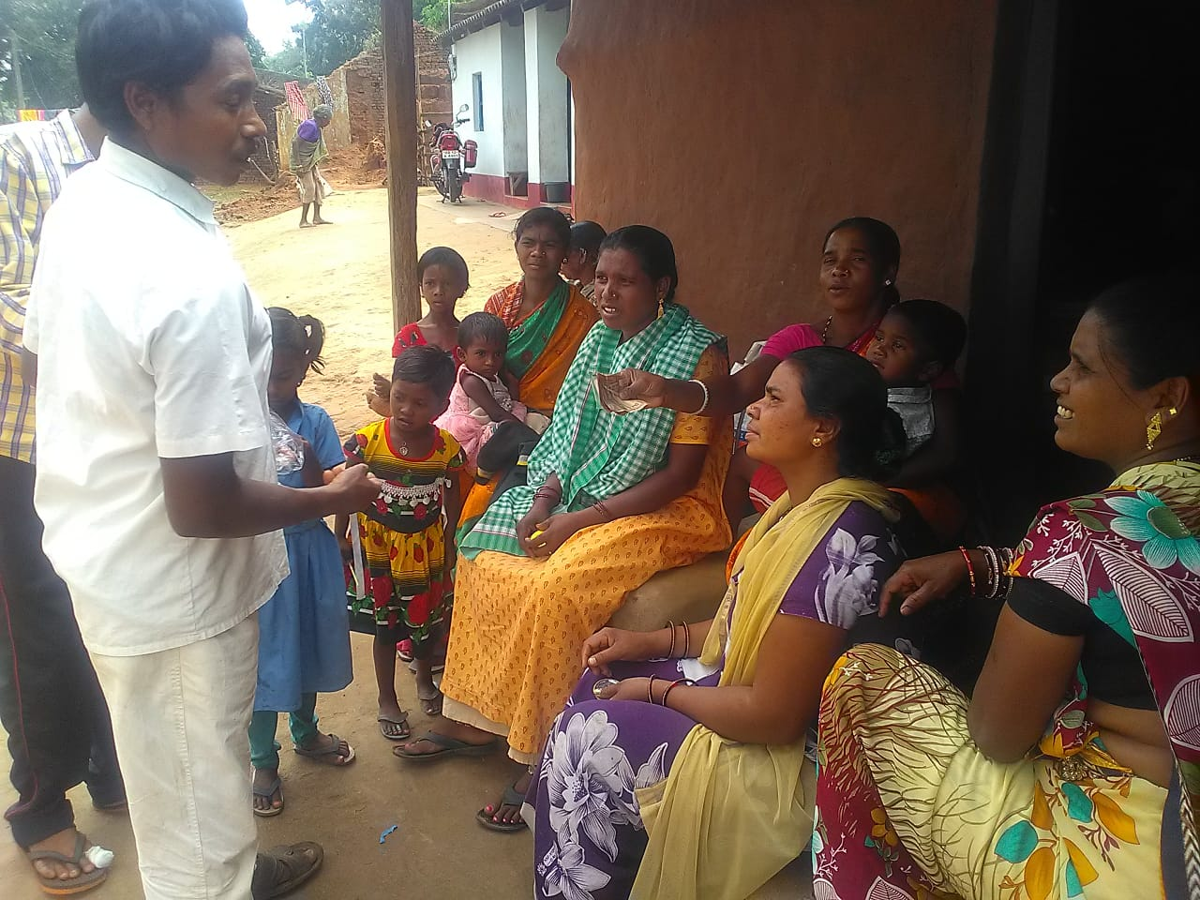
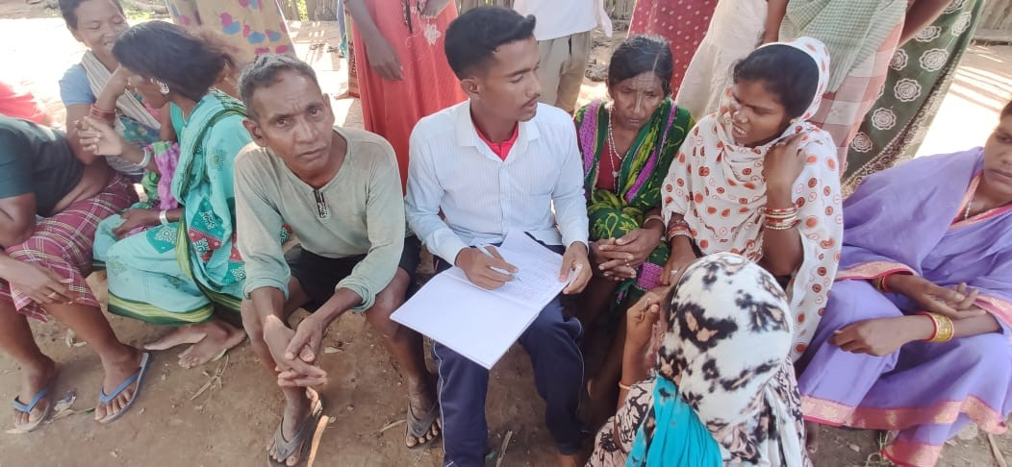
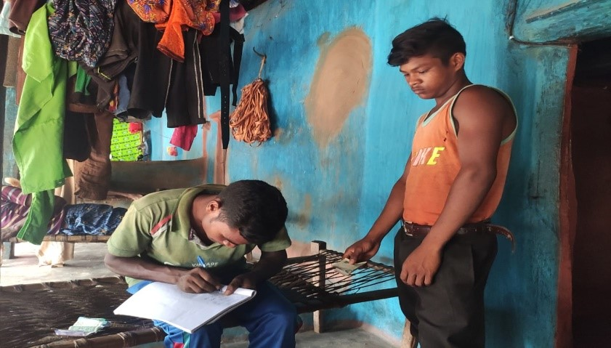
Contribution collection for health kit box

Slide 11
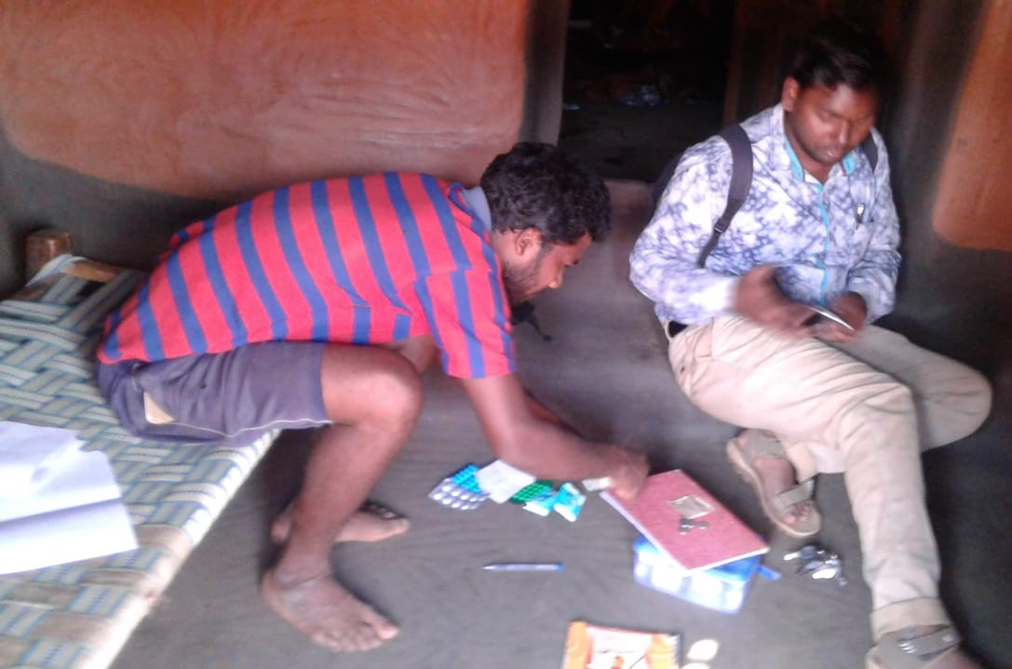
Documentation of the health kit and medicine

Slide 12
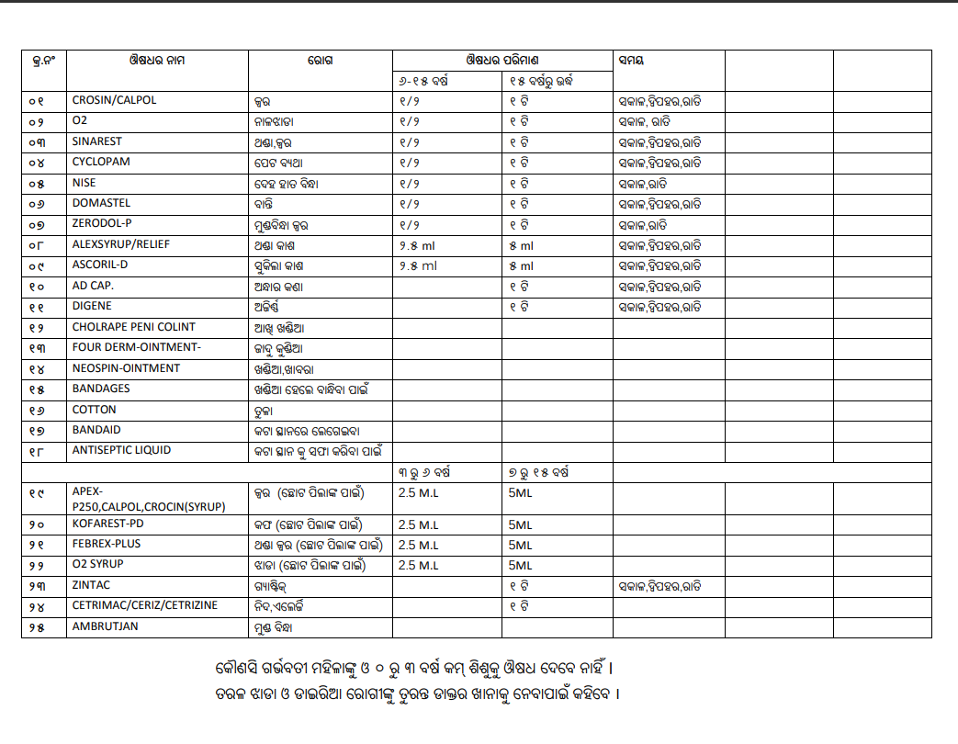
List of Medicines

Slide 13
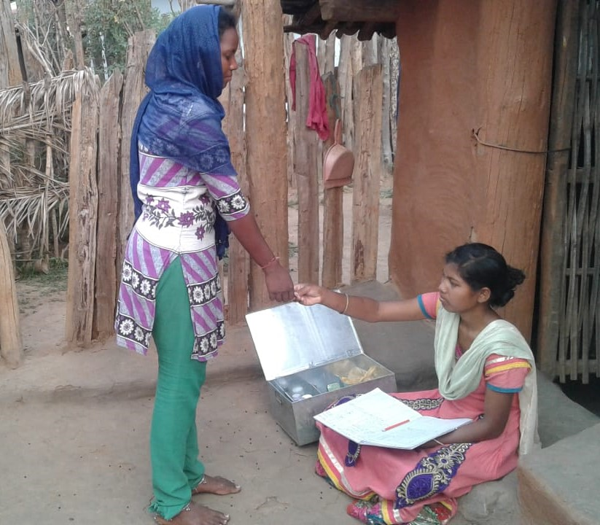
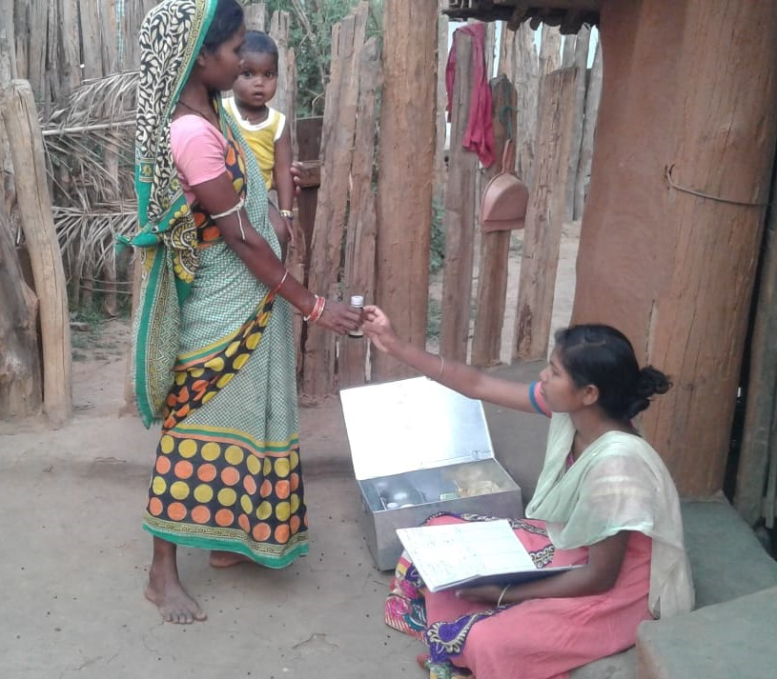
Distribution of the medicine through Swathya Sathi

Slide 14
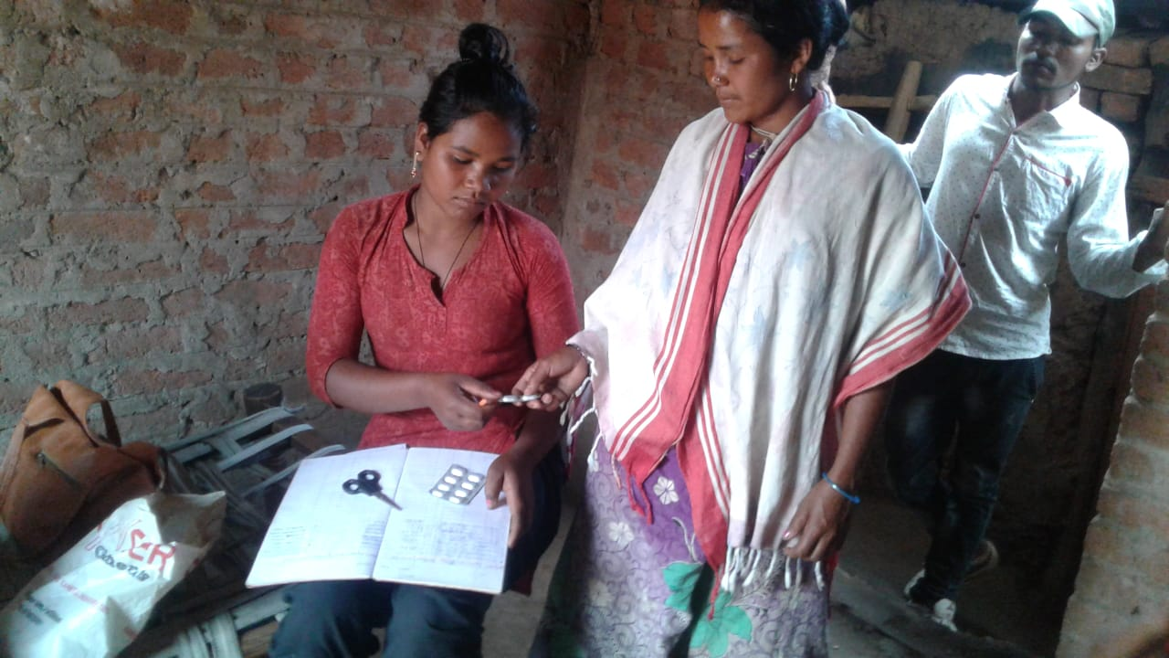
Medicine distribution via Swasthya Sathi

Slide 15
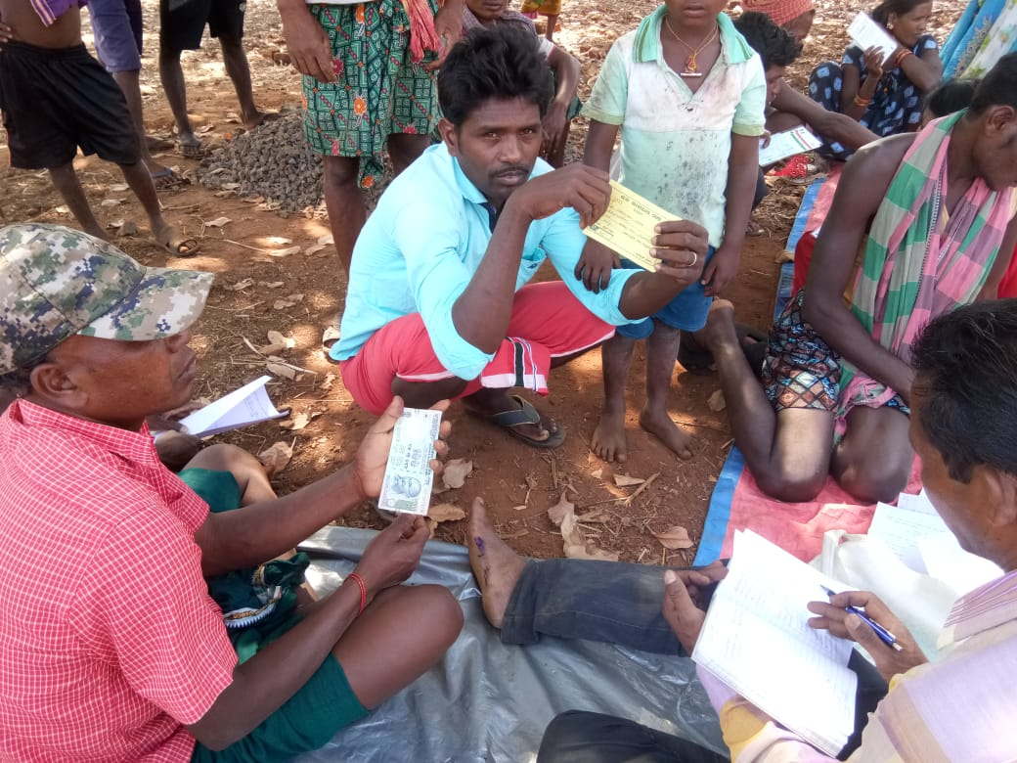
Major Milestone
Started work in 1 Block, now in 4 Blocks
Out of 635 villages, covered 440
Till date, 186 Health Kit have been formed through community contributions
Health Kit usage & maintenance training given to 104 Swasthya Sathis
Rs. 43,590/- collected from the community for the formation of Health Kit
So far, 1658 persons from 1373 households benefitted from the Health Kit

Slide 16
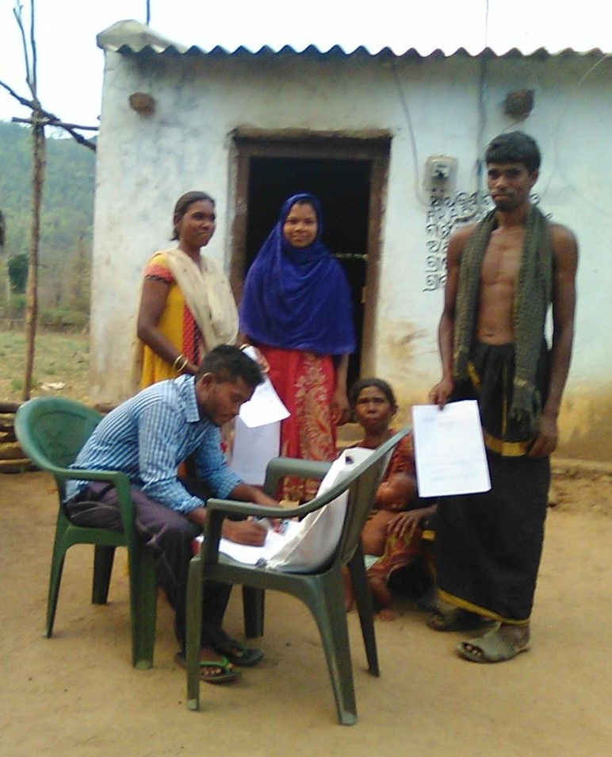
Major Milestone
200 households selected for Nutrition Kitchen Garden (NKG)
Formation of 160 new Village Level Committees
Indirect saving of Rs.331.600/-
(1658H.H @ Rs.200/-) Minimum
126 wall writing organized on Education, PDS, MGNREGA, NKG & COVID-19 in different strategic locations
Consultations with ASHAs , AWWs , SHG members and 45 other stakeholders

Slide 17
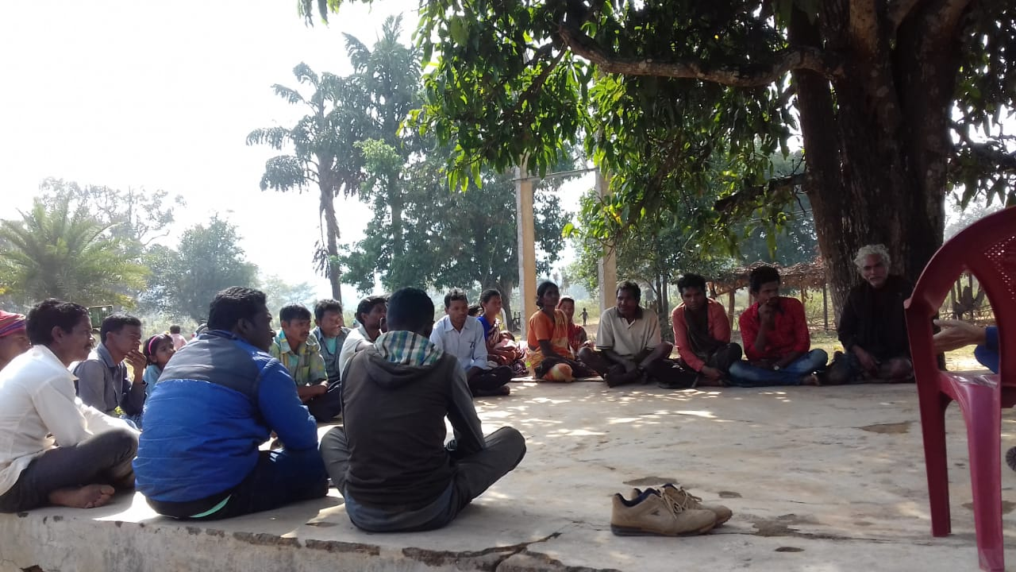
Atmashakti Trust

